Slide 1
Dodgeball for Heart
Amanda McCristal
TE 802
Professional Service Project

Slide 2
The American Heart Association; Quick Facts
Heart disease is the No. 1 killer of women age 20 and over, but it is largely preventable. In fact, up to 80 % of cardiac events in women may be prevented. Raising awareness saves lives.
While 1 in 30 American women die of breast cancer, 1 in 3 women die from cardiovascular disease.
Overweight children are more likely to have abnormally thick heart muscle tissue when they become an adult, which increases the risk of heart attack and heart failure.
This year about 1.2 million Americans will have a first or repeat coronary attack. About 452,000 of them will die. Coronary heart disease is our nation’s leading cause of death.
The American Heart Association is 2nd to the federal government as a source of funding for cardiovascular and stroke research.

Slide 3
Announcements/Posters!
Dodgeball for Heart!
Dodgeball for Heart is this Wednesday, December 7th, during your grade's Physical Education hour! 6th graders: play during 5th hour. 7th graders: play during 6th hour. 8th graders: play during 7th hour. The cost is $10.00 to play and that includes your entry into the tournament and a red "Tackle Heart Disease" t-shirt. You must have 4 players on a team in order to enter. Remember to wear your t-shirt on Wednesday, that is your ticket into the tournament! Please sign up and come support the American Heart Association!

Slide 4
How the fundraiser works…
The American Heart Association Provides all t-shirts.
Students must pay $10.00 each to play.
Teams must have 4 people.
Games consist of 3 minutes.
The tournament takes place during the school day, (or you could do the event after school and have spectators!)
Parents and friends can also purchase a shirt for $10.00

Slide 5
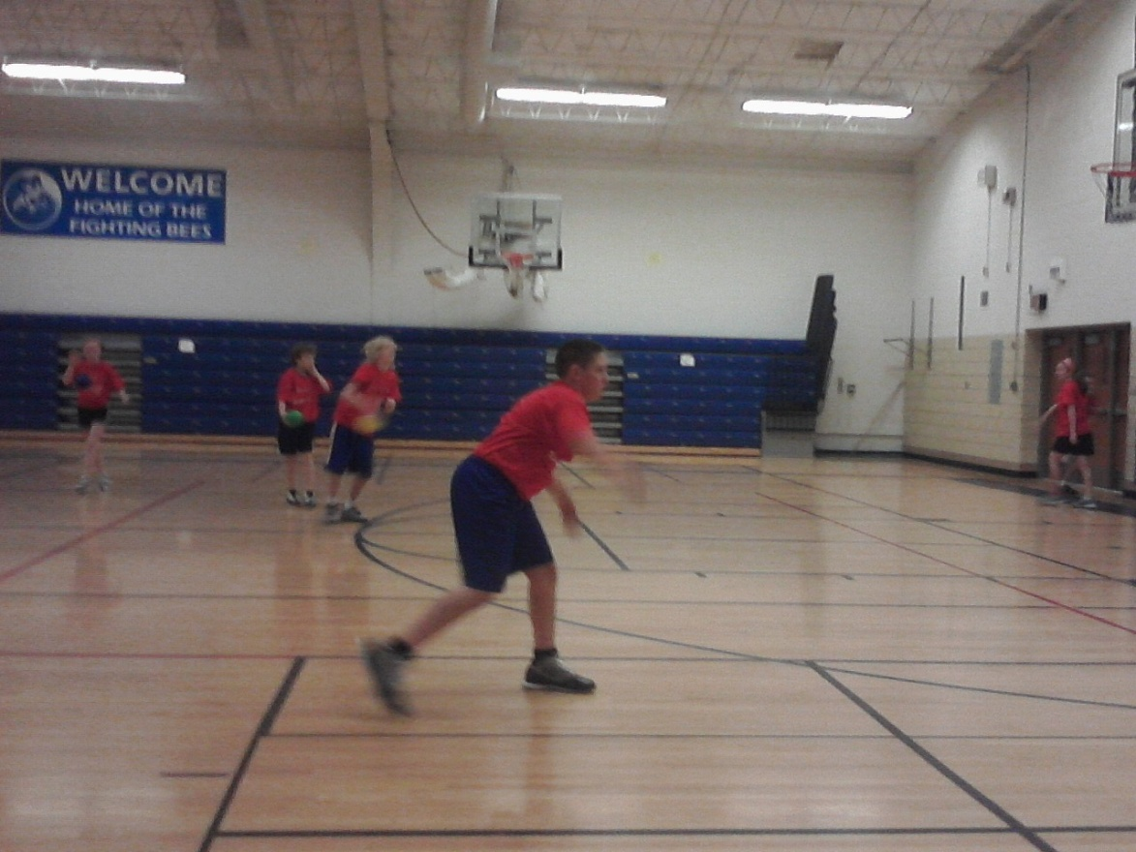
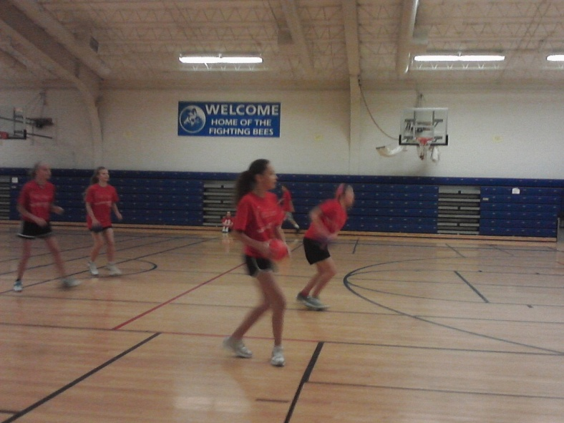
Candid Captures Wednesday, December 7th

Slide 6
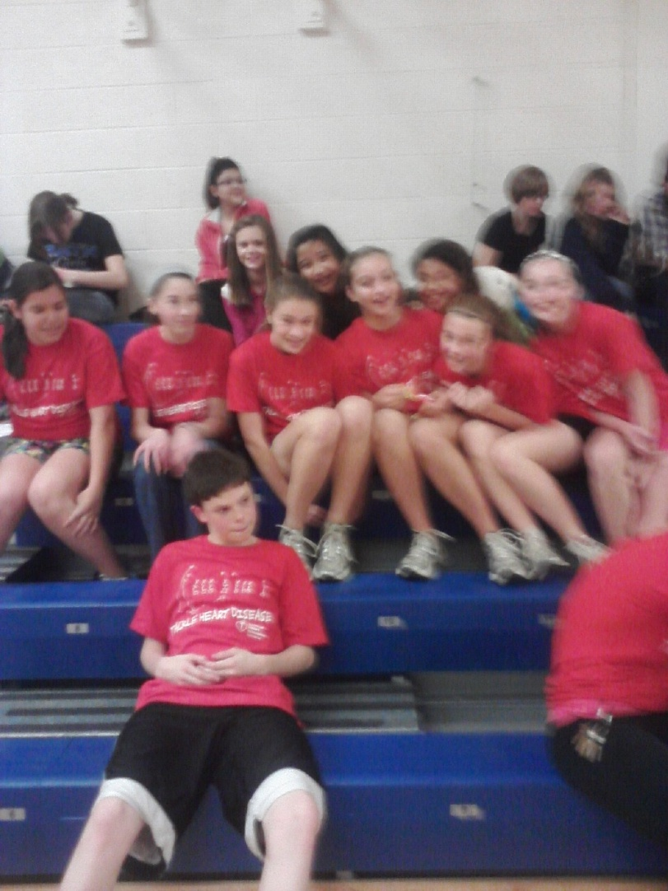
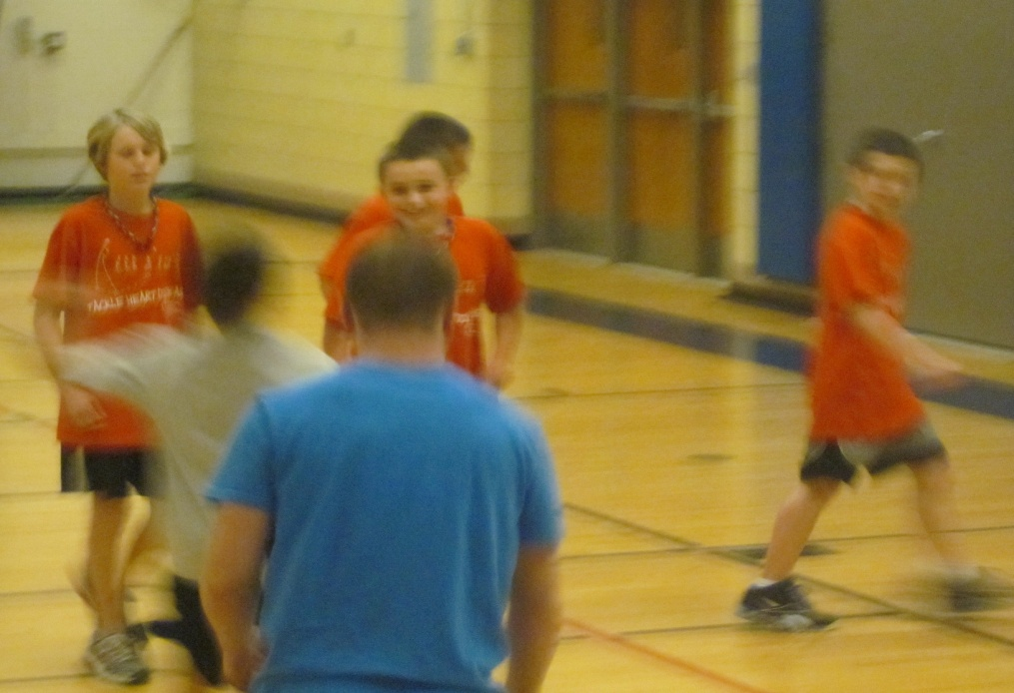
More tournament action…

Slide 7
Let’s go girls!

Slide 8
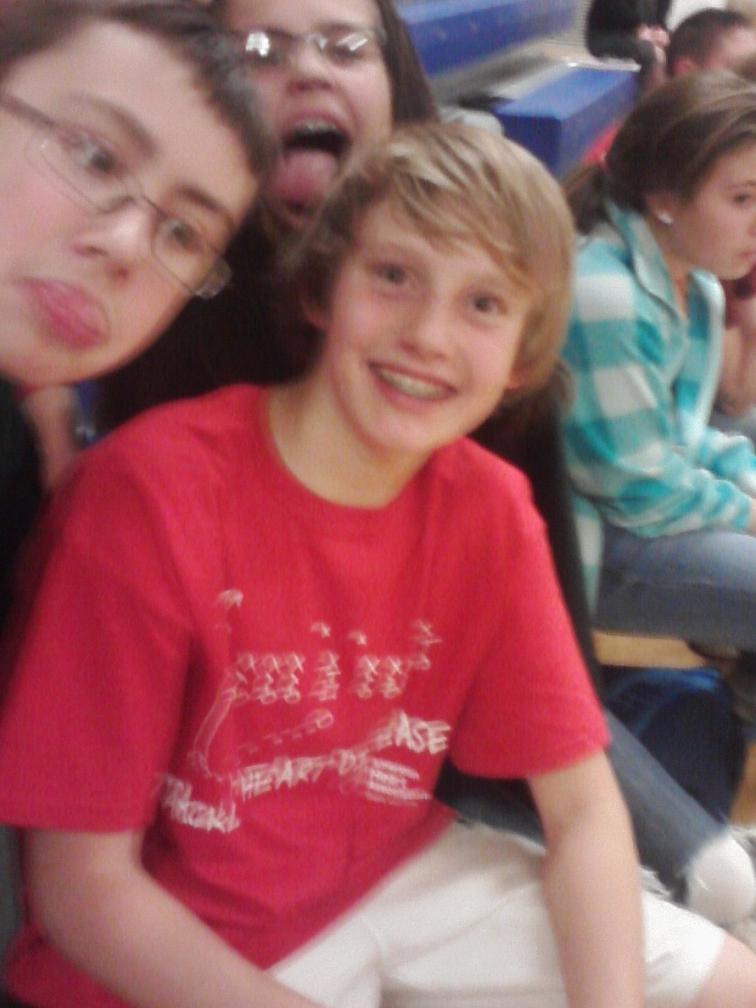
Bring on the tournament!

Slide 9
Cheering on our classmates…

Slide 10
Dodgeball for Heart Flyer

Slide 11
Thank you for supporting the American Heart Association!

Slide 12
Overall…..
We raised just over $1,000 for the American Heart Association! 26 teams played! 104 students participated!

